Slide 1

EXCEL Capstone Project FIFA 2019 Players Data
Guided by Karmugilan Jayachandiran
By NITIN S

Slide 2
Problem Statement
Rating per position.
Highest overall with respect to position.
Preferred Foot by the players.
Highest bid among the players.
Top 5 players.
Country
Value
Preferred Foot
Position
Age of the players.
Oldest player.

Slide 3
N. Kanté | J. Oblak | N. Kanté | J. Pavlenka | L. Sané | De Gea | K. Mbappé | K. Mbappé | N. Kanté | J. Oblak | N. Kanté | De Gea | K. Mbappé | N. Kanté | Neymar Jr | M. Gómez | D. Sánchez | L. Sané | De Gea | De Gea | S. Umtiti | L. Messi | K. Mbappé | De Gea | L. Sané | M. Gómez | L. Messi

Slide 5
Top 5 Players
L. Messi
COUNTRY | Argentina
VALUE | €110.5M
PREFERRED FOOT | Left
POSITION | RF

Slide 7
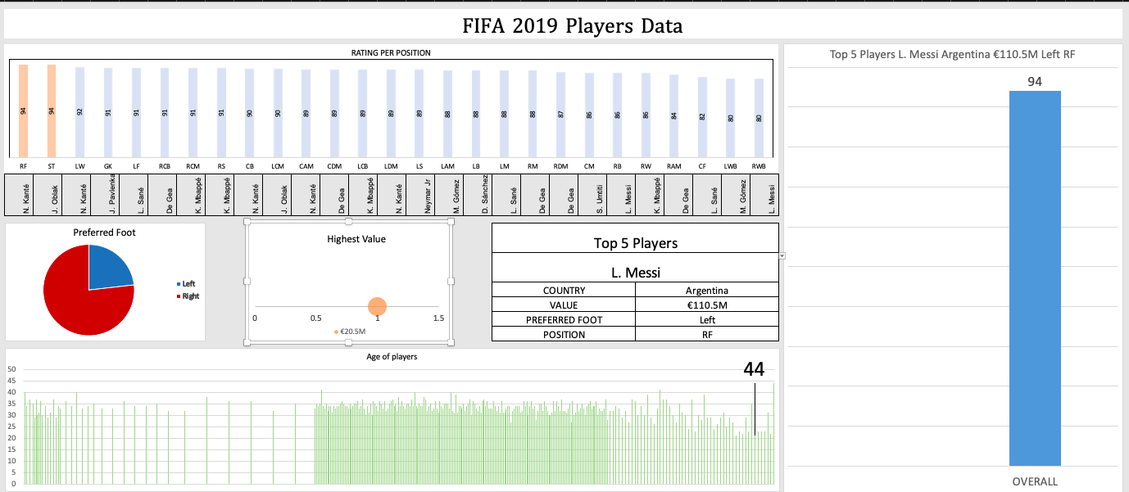

Slide 8
Excel file with Detailed Analysis
Position | Overall | Maximum | Player | Nationality | Cost
RF | 94 | 94 | L. Messi | Argentina | €110.5M
ST | 94 | 94 | L. Messi | Argentina | €110.5M
LW | 92 | #NAME? | Neymar Jr | Brazil | €118.5M
GK | 91 | #NAME? | De Gea | Spain | €72M
LF | 91 | #NAME? | De Gea | Spain | €72M
RCB | 91 | #NAME? | De Gea | Spain | €72M
RCM | 91 | #NAME? | De Gea | Spain | €72M
RS | 91 | #NAME? | De Gea | Spain | €72M
CB | 90 | #NAME? | J. Oblak | Slovenia | €68M
LCM | 90 | #NAME? | J. Oblak | Slovenia | €68M
CAM | 89 | #NAME? | N. Kanté | France | €63M
CDM | 89 | #NAME? | N. Kanté | France | €63M
LCB | 89 | #NAME? | N. Kanté | France | €63M
LDM | 89 | #NAME? | N. Kanté | France | €63M
LS | 89 | #NAME? | N. Kanté | France | €63M
LAM | 88 | #NAME? | K. Mbappé | France | €81M
LB | 88 | #NAME? | K. Mbappé | France | €81M
LM | 88 | #NAME? | K. Mbappé | France | €81M
RM | 88 | #NAME? | K. Mbappé | France | €81M
RDM | 87 | #NAME? | S. Umtiti | France | €57M
CM | 86 | #NAME? | L. Sané | Germany | €61M
RB | 86 | #NAME? | L. Sané | Germany | €61M
RW | 86 | #NAME? | L. Sané | Germany | €61M
RAM | 84 | #NAME? | D. Sánchez | Colombia | €34M
CF | 82 | #NAME? | J. Pavlenka | Czech Republic | €19.5M
LWB | 80 | #NAME? | M. Gómez | Uruguay | €20.5M
RWB | 80 | #NAME? | M. Gómez | Uruguay | €20.5M
Top 5 Players
Player | L. Messi | Neymar Jr | De Gea | J. Oblak | N. Kanté
Country | Argentina | Brazil | Spain | Slovenia | France
Value | €110.5M | €118.5M | €72M | €68M | €63M
Position | Left | Right | Right | Right | Right
Overall | 94 | 92 | 91 | 90 | 89
Position | RF | LW | RCB | LCM | CDM
Count of Preferred Foot
Preferred Foot | Total
Left | 4211
Right | 13948
(blank)
Grand Total | 18159

Slide 9
Summary
Right forward and Striker was the position in the FIFA 2019, which has the highest overall.
Most of the players preferred their right leg to play.
L. Messi was the highest paid footballer in FIFA 2019.
The top 5 players are L.Messi, Neymar, De Gea, J. Oblak, N.Kante with respect to the different position.
The top 5 players are from Argentina, Brazil, Spain, Slovenia and France.
The highest overall was being backed by L.Messi in two different position.
The top 5 players preferred right foot.
The top 5 players are from
The oldest player in the FIFA 2019 was T. Warner.
I have placed the link of the video here. https://drive.google.com/drive/folders/1uOC6YLHHS0TXVhCAugQ6VGSfuLEv4SKM?usp=sharing

Slide 10
Conclusion
In Conclusion, I was able to address all the problem statements through the visualization of the dashboard. I feel that now I am having a good knowledge on some of the concepts that I had been trained in the excel. I found this project to be very useful in making a creative dashboard for visualization. I have learnt many more things while undergoing this project.

Slide 11
THANK YOU!

